Slide 1

Your past, your present and your future

Slide 2


Slide 3


Slide 4
IDEA
What is Capsulefy?

Slide 5





Time capsule

Slide 6


Payment plans
 | Free | Premium
Price | 0 € | 11.99 €
Storage | 20 MB/user | 500 MB/capsule
Social network and email integration
Capsule scheduling | 1 year | No limit
Capsule expiration | 6 months after release | No expiration
Modular and private capsules

Slide 7
TECHNOLOGIES
What stack do we use?

Slide 8




Web app
Users and capsules
Media storage
Social network

Slide 9
COMPETITORS
What makes us different?

Slide 10
 | Viajeros en el tiempo | Mytimecapsule | Miigen | thetimecapsule | Capsulefy
Automatic content publication
Free plan
Premium plan
Images
Videos
Social network integration
Deadman switch

Slide 11
TEAM
Who is behind?

Slide 12
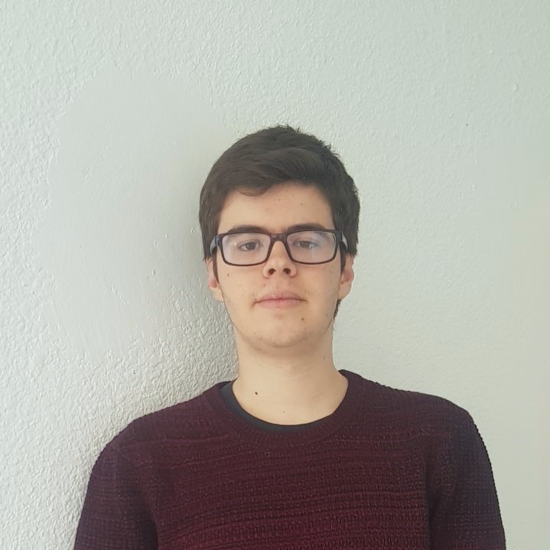
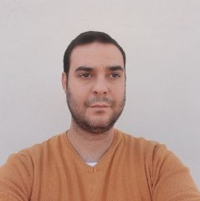




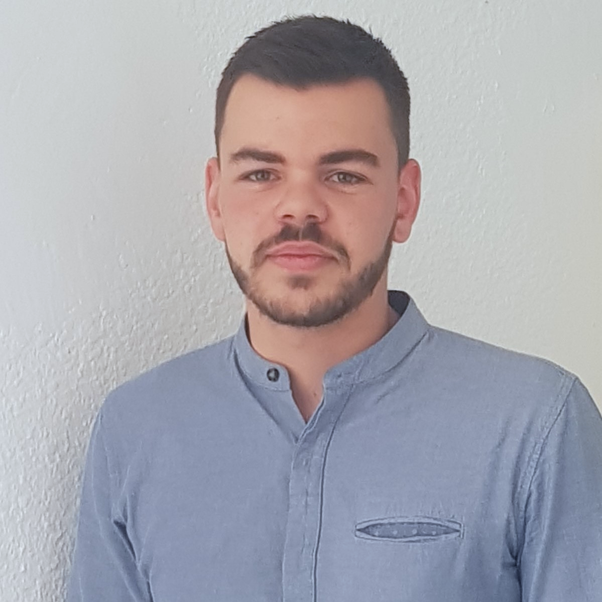
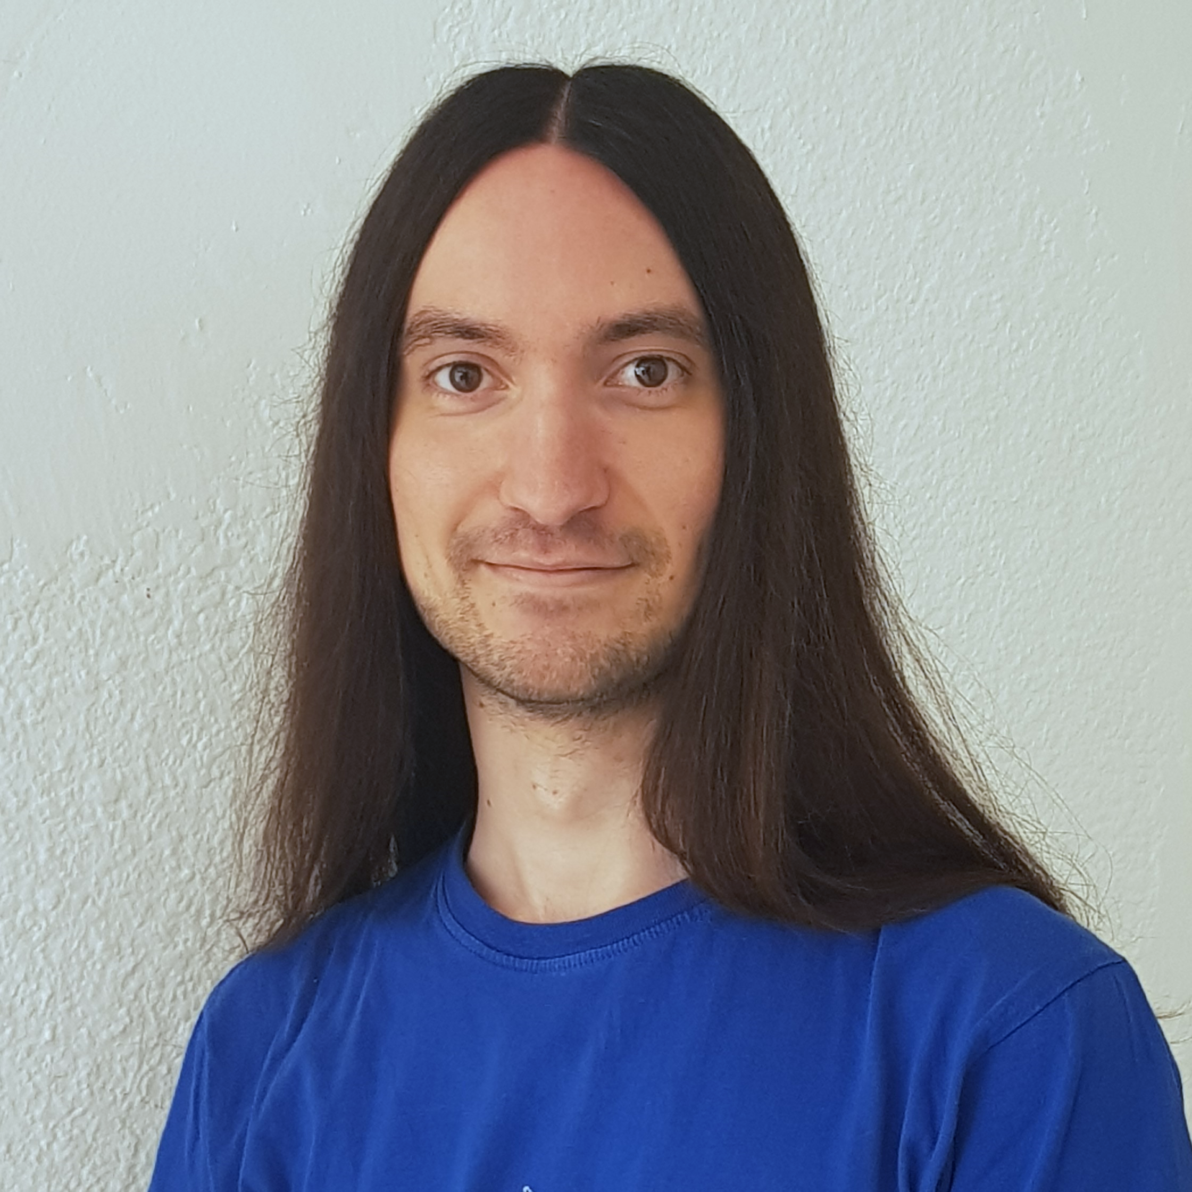


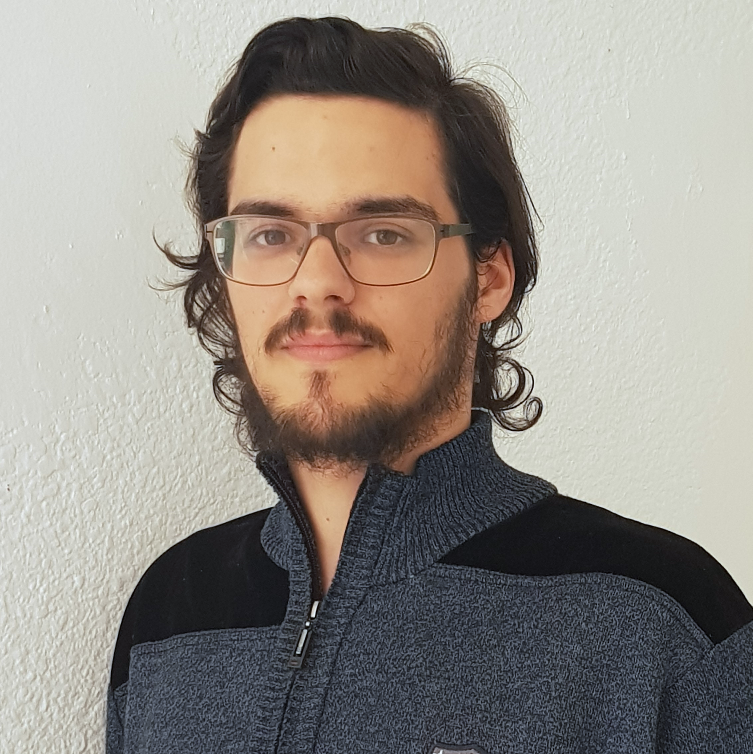



Pablo Rebollo
Project manager, backend developer
Juan Rodríguez
Requirements engineer, backend developer
Adrián Cantón
Business manager, full-stack developer
Rafael Fresno
Backend developer, API integration
Daniel Carpio
Analist,
frontend developer

Slide 13
COSTS
How much does Capsulefy cost?

Slide 14
Project duration | 4 months
Salaries | 20.80 €/hour
Hours per month | 40
Equipment | 306 €
Hosting, advertising and support | 18,729 €
Risk prevention | 10% (2,724 €)
Total | 44,968 €

Slide 15
DEMO
How does the system look like?

Slide 16
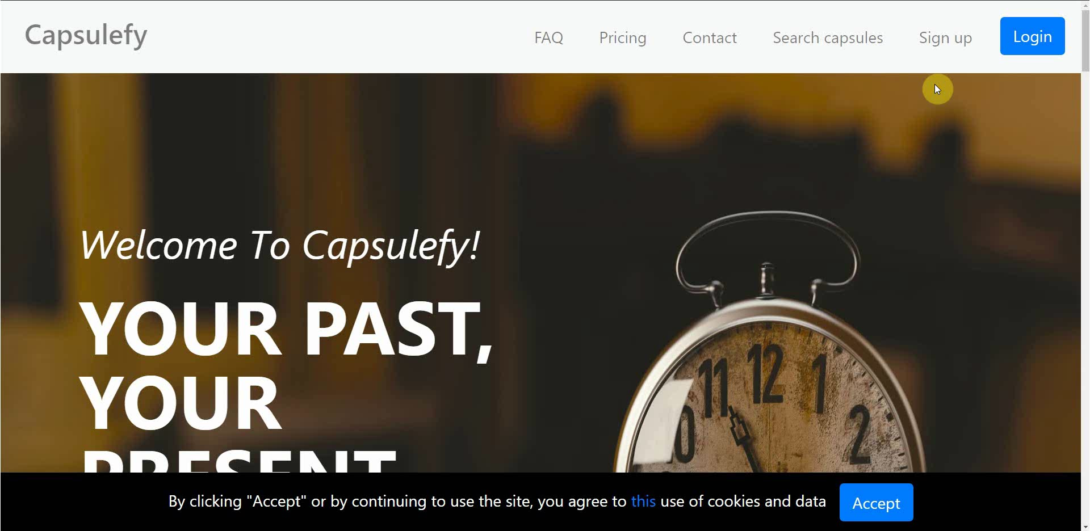
No logged user – Sign up

Slide 17
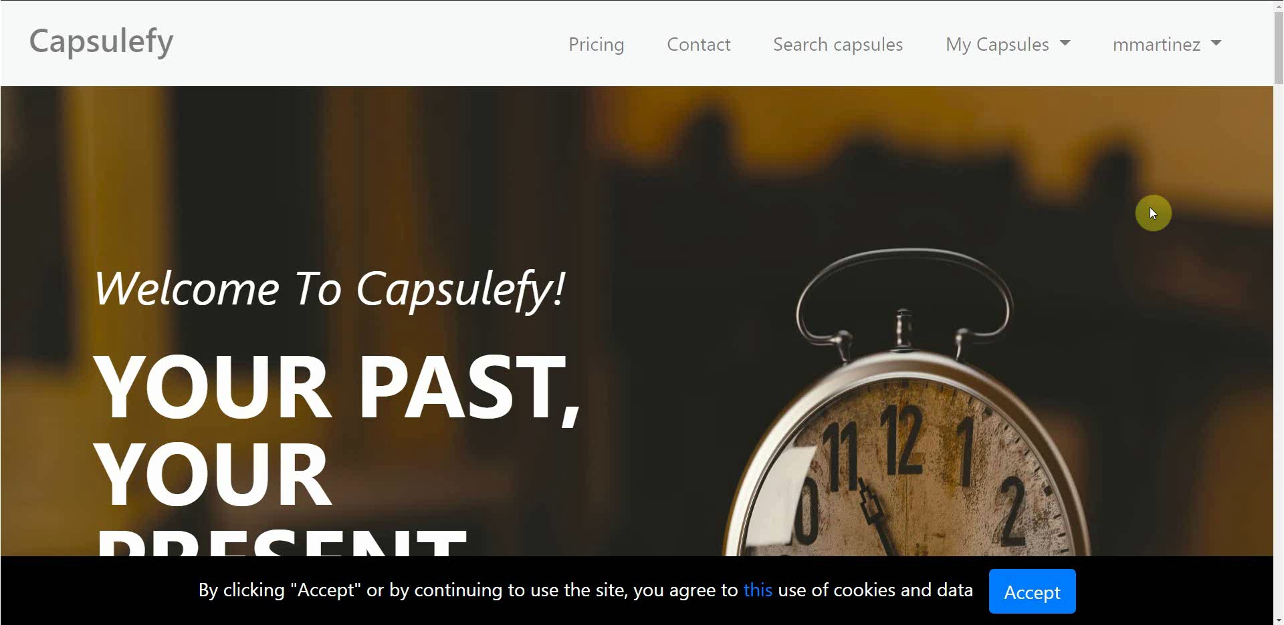
Logged-in user – Change password

Slide 18
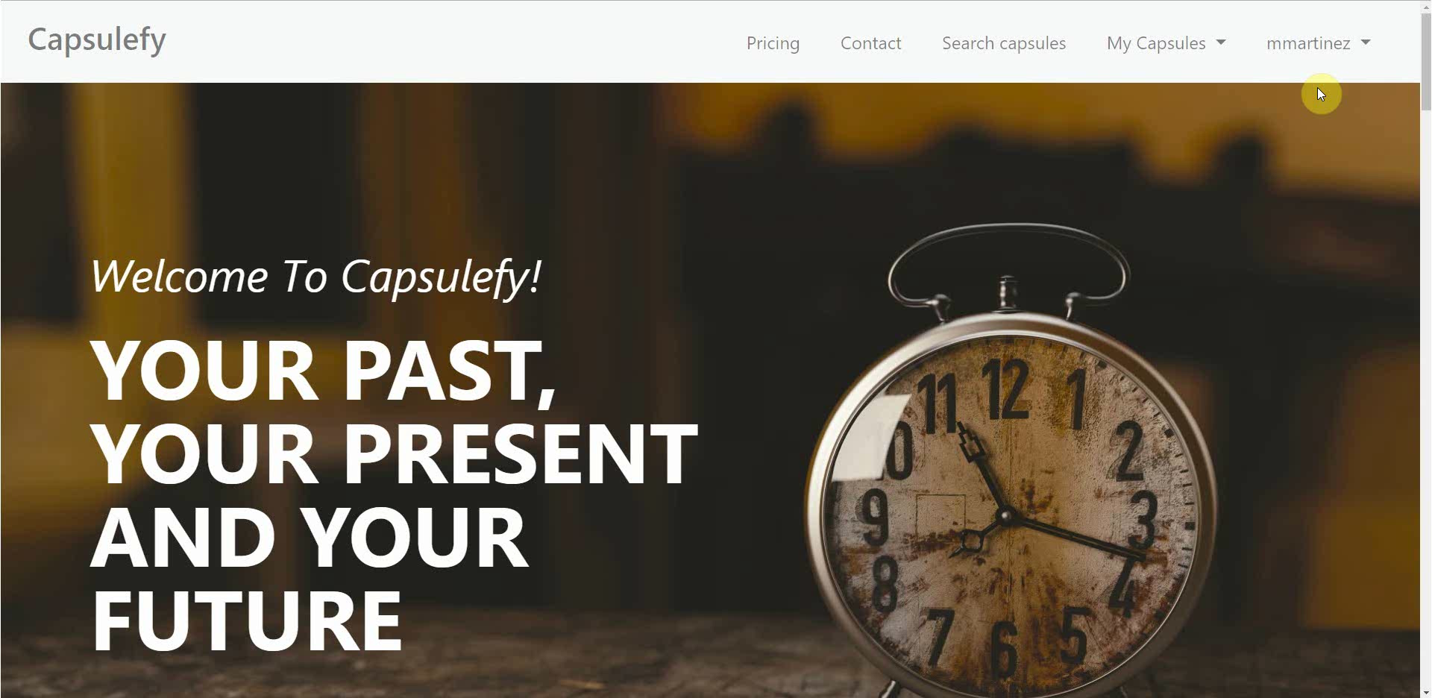
Logged-in user – Connect to Twitter

Slide 19
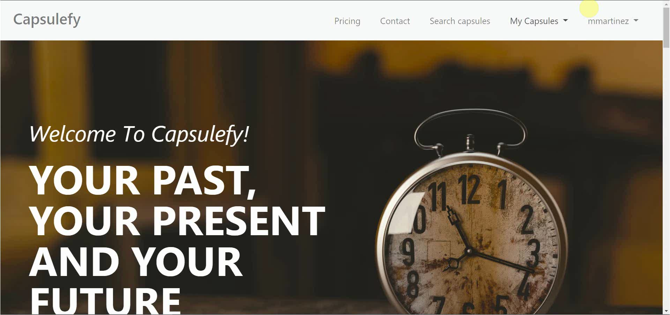
Logged-in user – Create and display capsule

Slide 20
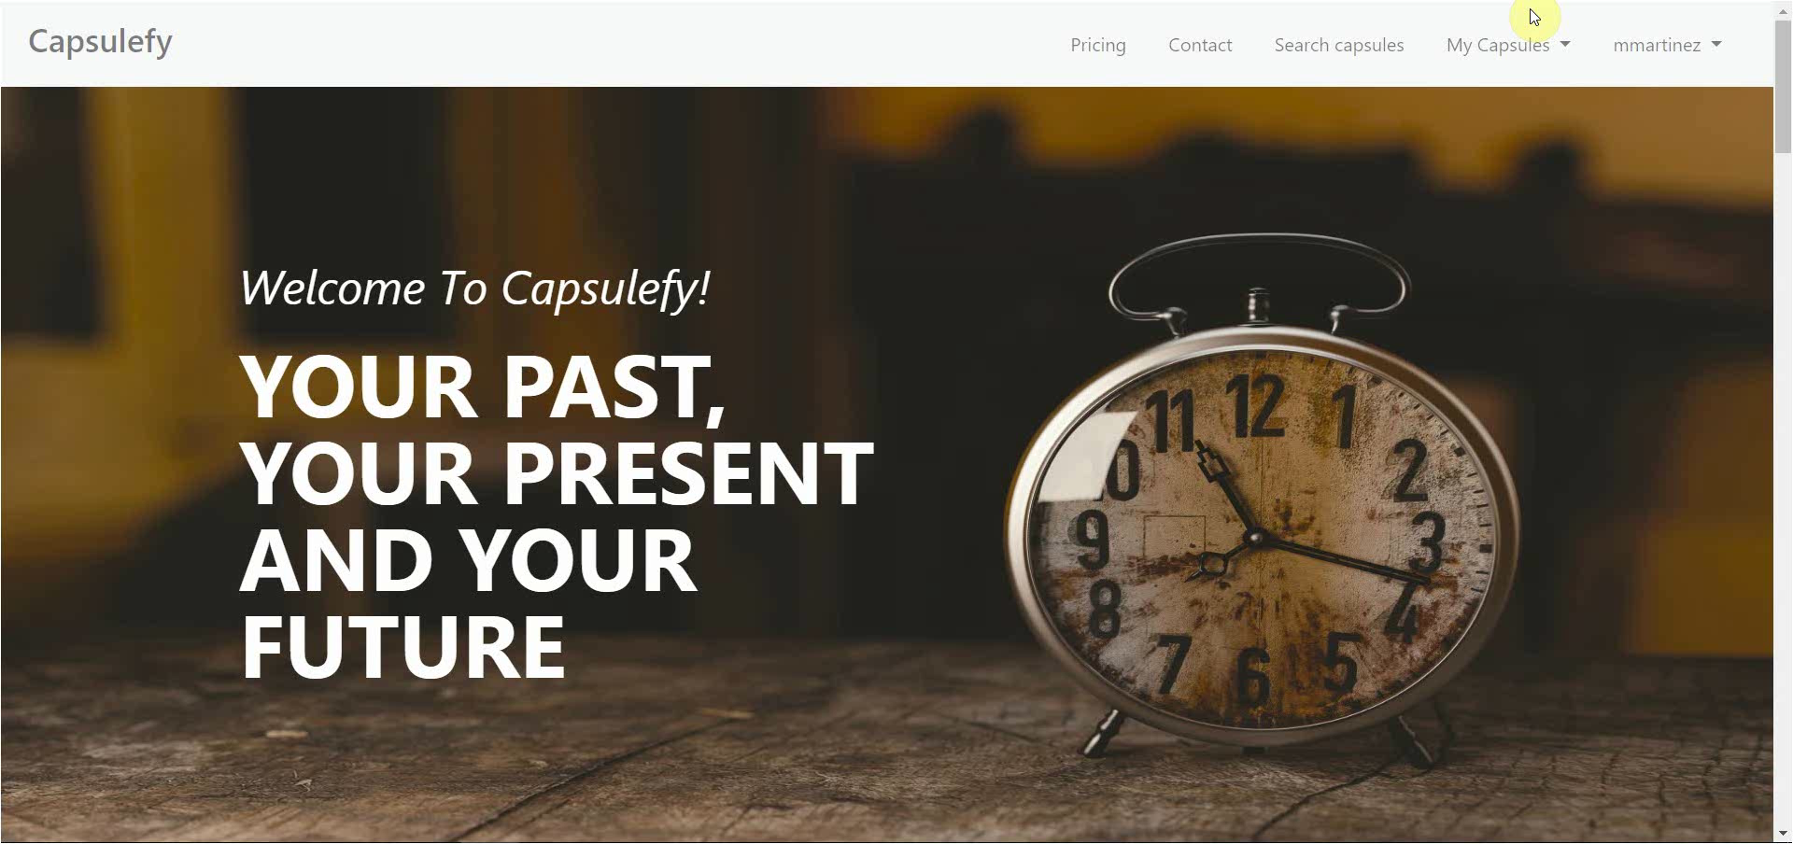
Logged-in user – Refresh timer

Slide 21

Logged-in user – Delete account

Slide 22

GDPR
How do we comply with GDPR?

Slide 23


Users may delete their profile or capsules

Slide 24


Users can send an email to request unauthorized data deletion

Slide 25

Users will be prompted to reset their password if suspicious activity is detected

Slide 26


Users can send an email to retrieve all their stored data

Slide 27

All this information, including cookie usage, is available on our website

Slide 28


Users must agree to our terms of service before registering

Slide 29
Project launch Week 1
May 13th – May 19th

Slide 30
 |  | May
Task | Assignees | 13 | 14 | 15 | 16 | 17 | 18 | 19
Initial meeting | All
Social media accounts | Juan
Target groups | Pablo
StartUS tasks | Adrián
Advertisement spot | Daniel
Social media marketing | Juan
Marketing strategy | Pablo
Update landing page | Daniel

Slide 31
 |  | May
Task | Assignees | 13 | 14 | 15 | 16 | 17 | 18 | 19
Remake demo videos | Adrián
Update costs | Pablo
Carry out SM marketing | Juan
Review populate | Pablo
Presentation | Rafael
Rehearsal | Pablo

Slide 32
Project launch Week 2
May 20th – May 24th

Slide 33
 |  | May
Task | Assignees | 20 | 21 | 22 | 23 | 24 | 25 | 26
Feedback meeting | All
User ad spot | Adrián
SM marketing | Juan
Investor ad spot | Juan
Future improvements | Daniel
Marketing costs | Pablo
Deploy app | Adrián, Daniel

Slide 34
 |  | May
Task | Assignees | 20 | 21 | 22 | 23 | 24 | 25 | 26
Update landing page | Daniel
Presentation | Rafael
Project launch doc | Pablo
Rehearsal | Pablo

Slide 35
Target users
Who would use Capsulefy?

Slide 36




Target groups
Social media users
Families
People with income
Any gender

Slide 37




Our main user
Man or woman
Married
(or plans to be)
Strong family relationships
With kids
(or plans to have)

Slide 38



Why not elder people?
May be more attached to their family, but…
Less tech savvy

Slide 39




Why not younger people?
May be more familiar with technology, but…
Not much money and long term thinking

Slide 40
Marketing campaign
How are we advertising Capsulefy?

Slide 41




Social networks
Twitter
Facebook
Instagram
YouTube
LinkedIn
@capsulefy
Capsulefy Comms
Capsulefy Project

Slide 42
Social networks
Two adversisement spots available on YouTube
22nd May: first Twitter and Facebook publications (videos and text)
26th and 30th May, 3rd and 7th June: other publications (images, discounts…)

Slide 43

Monthly advertising costs
220 €
140 €
150 €

Slide 44
Refinements
- People living in Spain
- Business category: ‘Cloud storage’
- Keywords: ‘Cápsulas del tiempo online’,
‘Cápsula del tiempo’, ‘Testamento digital’
220 €
Potential audience: 37611 people/month

Slide 45
Estimated performance
1746 – 2935 views/month
137 – 229 clicks/month
Each visit costs 1.2 €
220 €

Slide 46
Refinements
- People between 30 and 50 years
- Parents and married
- Interested in family
- Recently had a baby
- Interested in friendship
- Travel frequently
140 €

Slide 47
Estimated performance
6900 views/month
200 clicks/month
Each visit costs 1.4 €
140 €

Slide 48
Refinements
- People between 25 and 49 years
- Interested in:
· Travels with kids
· Luxury travels
· Fathers/mothers
· Parents of kids
· Upbringing of
teenagers
· Holiday
150 €

Slide 49
Potential audience size
600k people
Daily bidding: 5 €
150 €

Slide 50


Is this effective?
510 €/month * 6 months = 3060 €
9.5 €/sale
10% conversion rate
530 users
530

Slide 51
Discount campaigns
How are we promoting Capsulefy?

Slide 52



Discount campaigns
Free premium capsules during first week
20% discount during first month (8.99 €)
Referral system (during special dates)
%

Slide 53
Current costs
How are we managing costs?

Slide 54
Project duration | 12 weeks
Salaries | 13,390 €
Equipment | 325 €
Hosting, advertising and support | 18,729 €
Risk prevention | 10% (2,724 €)
Total | 35,168 €
Project completion | 95%
Spent budget | 78%
Total deviation | -7650 €

Slide 55
PILOTING PLAN
How are users testing Capsulefy?

Slide 56
Committed users
Name | Age
Francisco R. | 55
Javier A. | 19
Valentin A. | 19
Antonio G. | 26
José Manuel J. | 21
Name | Age
Sandra C. | 28
José Manuel C. | 21
Rafael C. | 55
Antonio C. | 54
Auxiliadora L. | 50

Slide 57
After development
Users receive and fill form
May 4 – May 12
Receive users feedback
May 12
Planification
May 13

Slide 58
Final FEEDBACK RESULTS
What did users say?

Slide 59

“It would be nice to be able to log in with Facebook”

Slide 60
“You could create some familiar plans or promotions”

Slide 61
“I miss some payment options other than PayPal”

Slide 62
“The deadman timer could even be used for your own reminders”

Slide 63
“The interface is nice and clear. I did not experience any problem”

Slide 64
Future improvements
How will we improve Capsulefy in the future?

Slide 65


More admin control
Display more indicators
Ability to change price
To modify some parameters
In the admin dashboard
During temporal promotions

Slide 66


Promotional codes
More payment options
Integrate with other services
To attract new clients
Such as credit card
Like Facebook and Instagram

Slide 67
Promotional codes
More payment options
Integrate with other services
To attract new clients
Such as credit card
Like Facebook and Instagram

Slide 68
Devising a business plan
May 27th – June 2nd

Slide 69
 |  | May |  |  |  |  | June
Task | Assignees | 27 | 28 | 29 | 30 | 31 | 1 | 2
Initial meeting | All
Study pricing | Pablo
Improve SWOT | Juan
Improve ROI | Daniel
Contingency plans | Adrián
Short/long term plans | Daniel, Juan
Presentation | Rafael
Rehearsal | Pablo

Slide 70
Thanks!
Upstream: https://capsulefy.herokuapp.com
Project launch: https://capsulefy05.herokuapp.com
Landing page: https://capsulefy01.herokuapp.com
Contact email: capsulefy.communications@gmail.com
GitHub releases: https://github.com/pabreblob/capsulefy/releases

Slide 71


Deadman switch
ON

Slide 72




Teamwork
Skills
Profitable work
Positive feedback

Slide 73

Realistic | 44968 – 46330 €
Optimistic | 43061 €
Pesimistic | 49054 €
Project duration: 4 months

Slide 74




Risk | Mitigation
Broken computer | Risk prevention funds
Changing terms of use | Monitor
Servers down | Monitor
Incompatible timetables | Reschedule

Slide 75
Year 1: 2000 sales
Balance: -25168 €
Year 2: 4000 sales
Balance: 11441 €
44968 €
39600 €
28159 €
19800 €
Costs
Earnings
Costs
Earnings

Slide 76
Year 3: 8000 sales
Balance: 36450 €
79200 €
29023 €
Costs
Earnings

Slide 77

What do we store?
Users:
- Full name
- Email
- Birthdate
- Notification email
- Social network token
Capsules:
- Content
- Files
- Emails
- Payment ID

Slide 78
Create manual
Create test suite
Test the system
Gather feedback
Fill form

Slide 79
Sprint 2
Users receive and fill form
March 30 – April 6
Development
April 8 – April 12
Receive users feedback
April 6
Planification
April 8

Slide 80
Sprint 3
Easter Week
Users receive and fill form
April 12 – April 22
Development
April 22 – May 3
Receive users feedback
April 22
Planification
April 22

Slide 81

GDPR and measure calculation costs are included in the corresponding members’ salaries

